Slide 1
Exploratory Data Analysis: World Happiness Report
Omar AlSuwaidi

Slide 2
Objectives
Investigate and study the happiness index of countries worldwide (according to the World Happiness Report)
Understand what factors, behaviours, and values influence a country's overall happiness
Use the happiness indicators to inform policy-making decisions as taken by leadership
Generate clear plots and visualizations, illustrating the most important key takeaways
Build a machine learning model that is able to predict the happiness index of a country given its factors

Slide 3
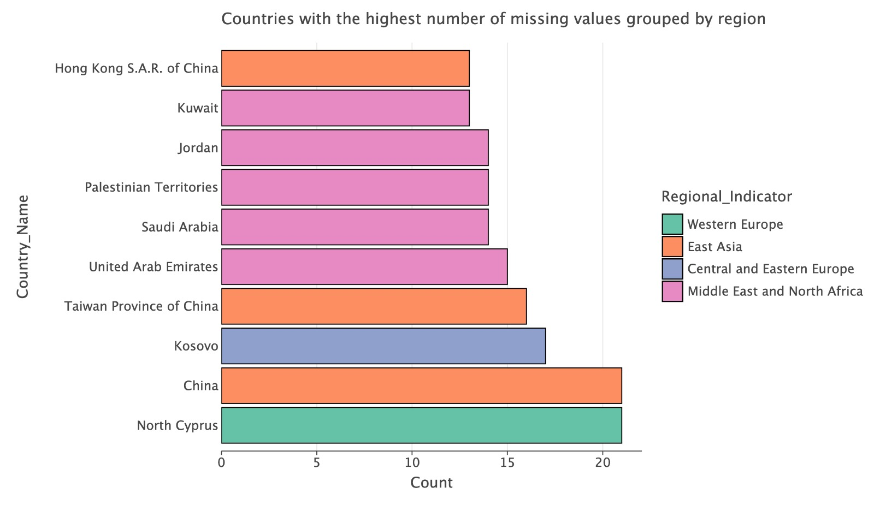
What’s missing from the report?
What does this say about these countries (are they hiding something)?
This can serve as a useful feature (indicator) for future prediction about these countries or regions

Slide 4
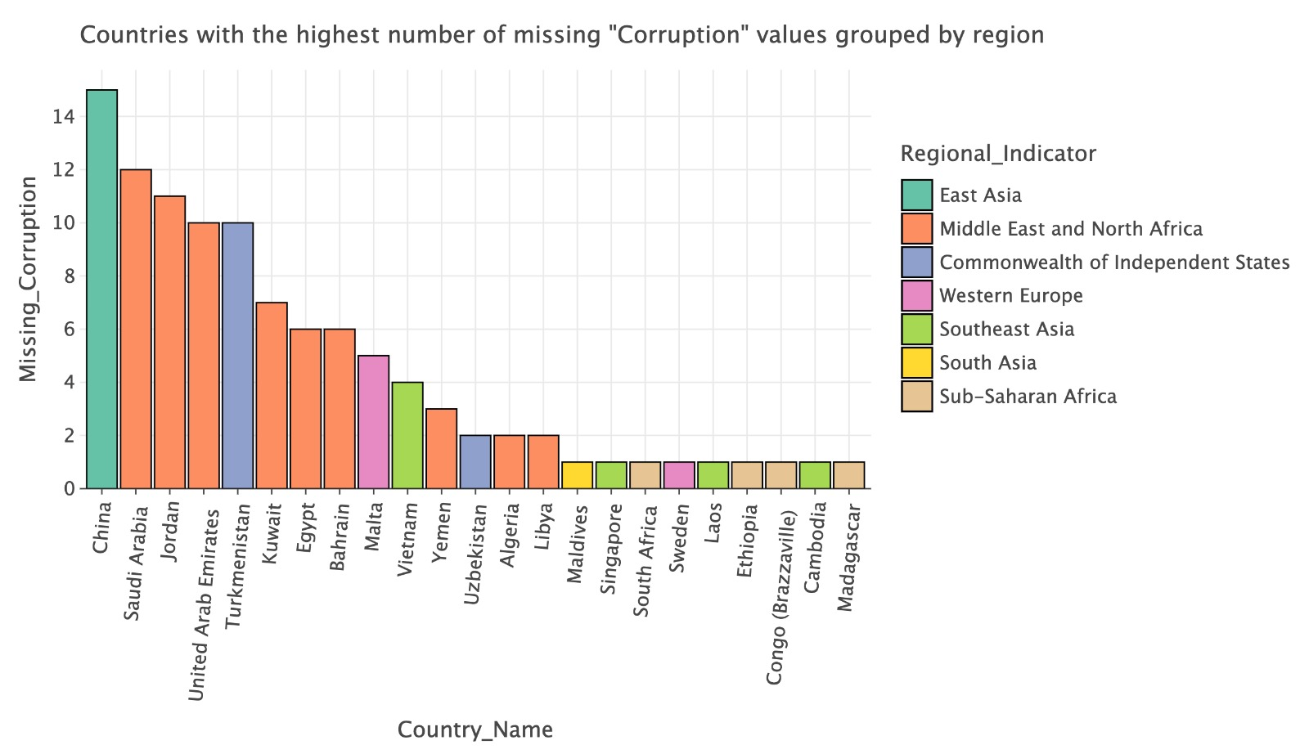
Which indicator was the most missing?
The indicator (feature) “Perceptions of Corruption” was missing the most (MENA tops the list)

Slide 5
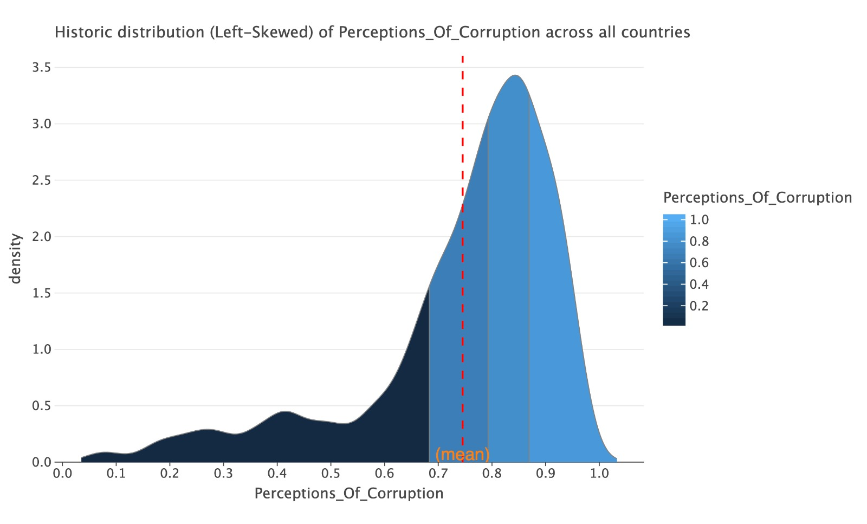
What does the distribution of corruption look like?
Since it’s a left-skewed distribution, this informs us that most countries worldwide are likely to be corrupt (lean towards the corruption side) except for a few!

Slide 6
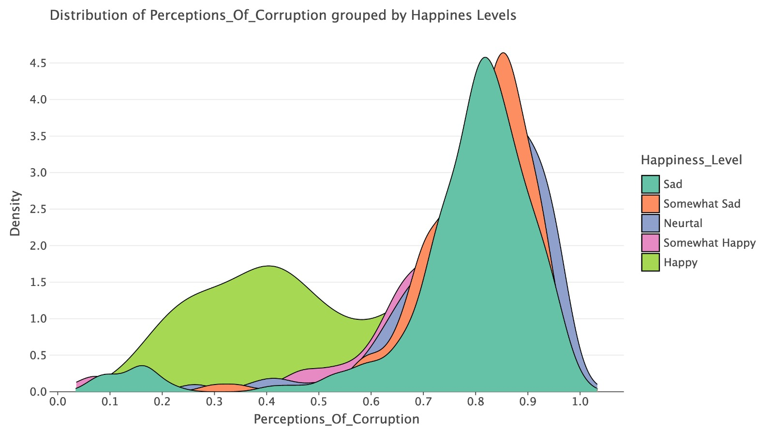
How is corruption broken down by happiness levels?
After categorizing each country into a “happiness level”, we can see that the happiest countries contribute the least to the corruption distribution (inverse relationship)

Slide 7
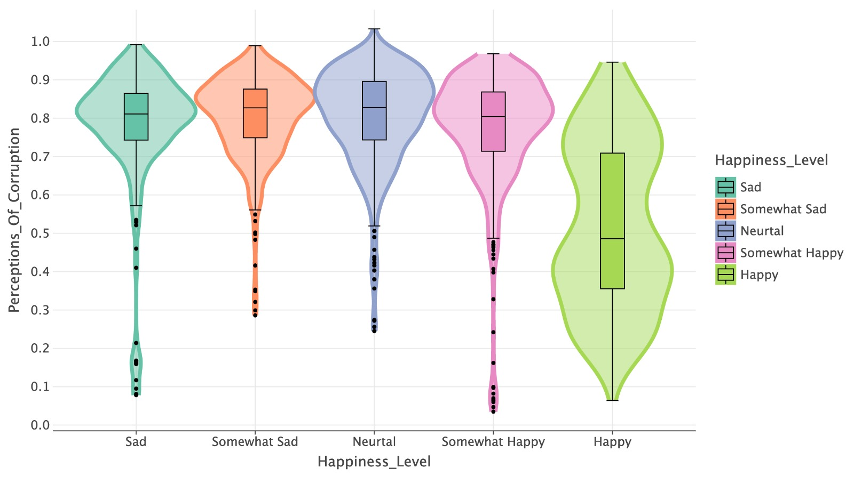
Quantifying corruption values by happiness levels

Slide 8
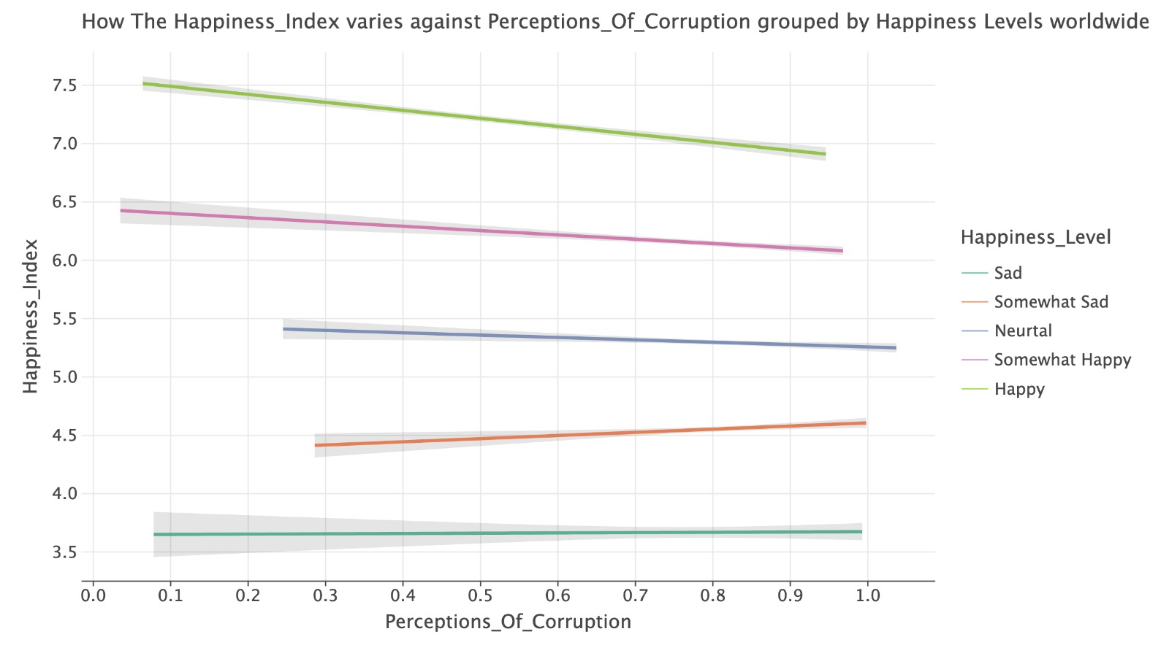
How do the different happiness level groups react to corruption?
The happiest nations react most negatively to rise in corruption, while the saddest ones remain stable; indicating there might be a threshold where beyond it, people stop caring about rise in corruption!
While most groups react negatively with rise in corruption, the “Somewhat Sad” group reacted positively, suggesting that in desperate nations, corruption might be mistakenly perceived as good!

Slide 9
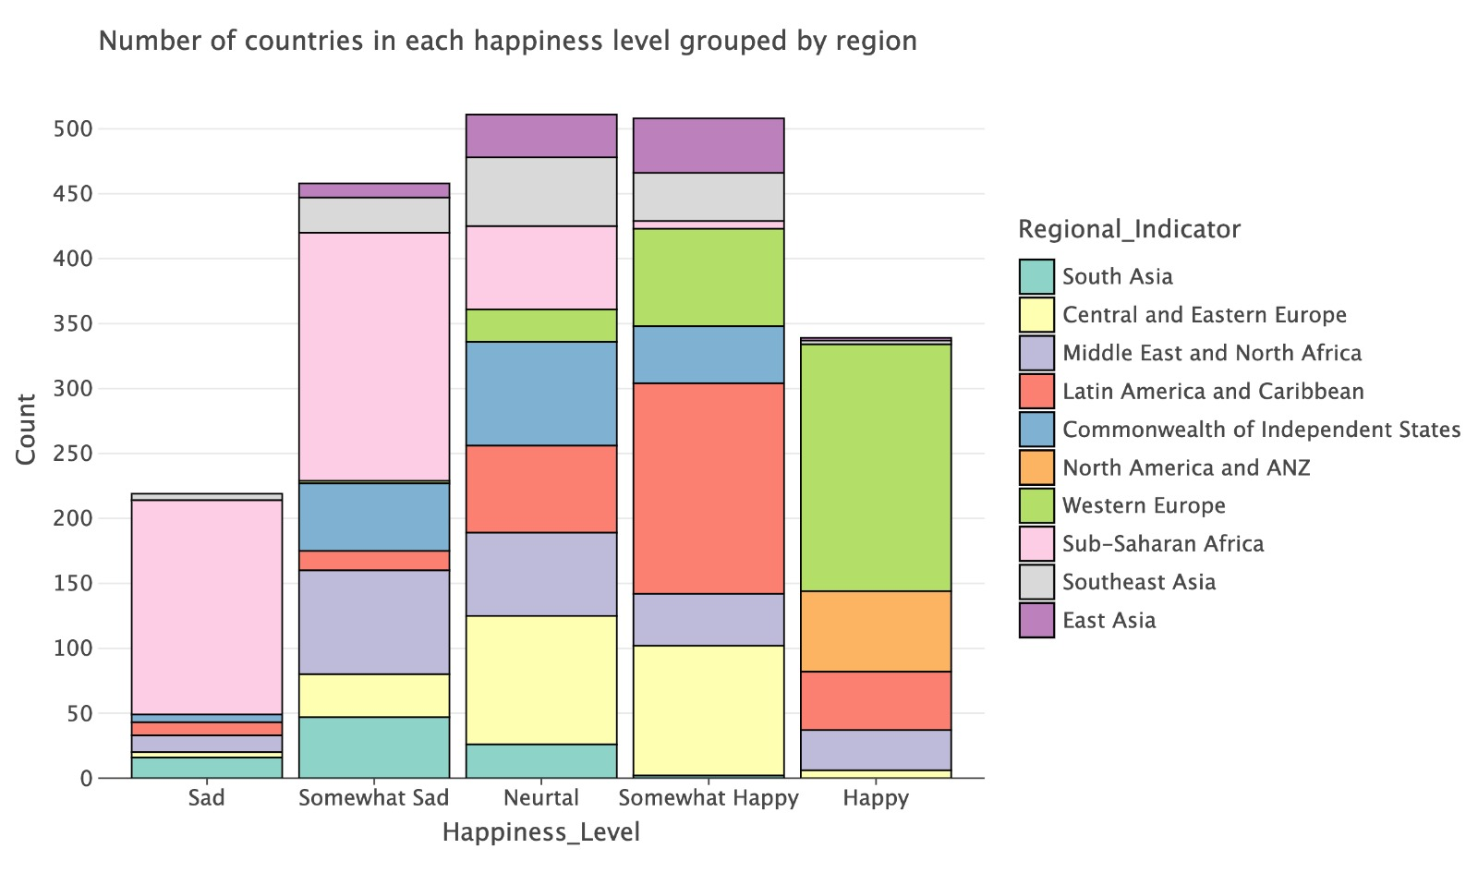
How many countries are in each happiness level?
We can see that the distribution of happiness is quite normally distributed, with “Neutral” being the most common happiness level

Slide 10
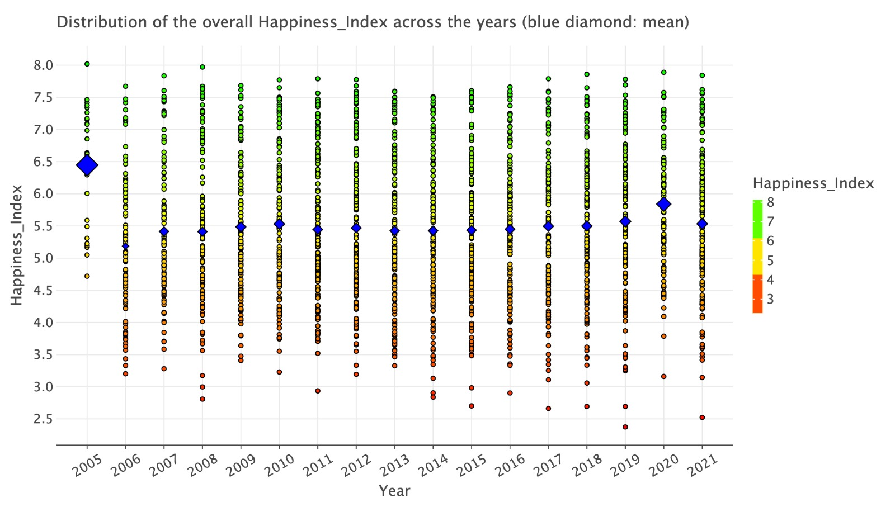
How did the overall happiness change over time?

Slide 11
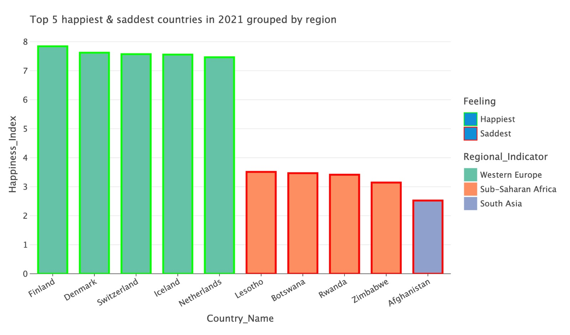
What are the top 5 happiest & saddest countries?
This information is vital as it can serve as a guiding heuristic to learn and adopt the best practices of the happiest countries while avoiding the pitfalls of the saddest ones!

Slide 12
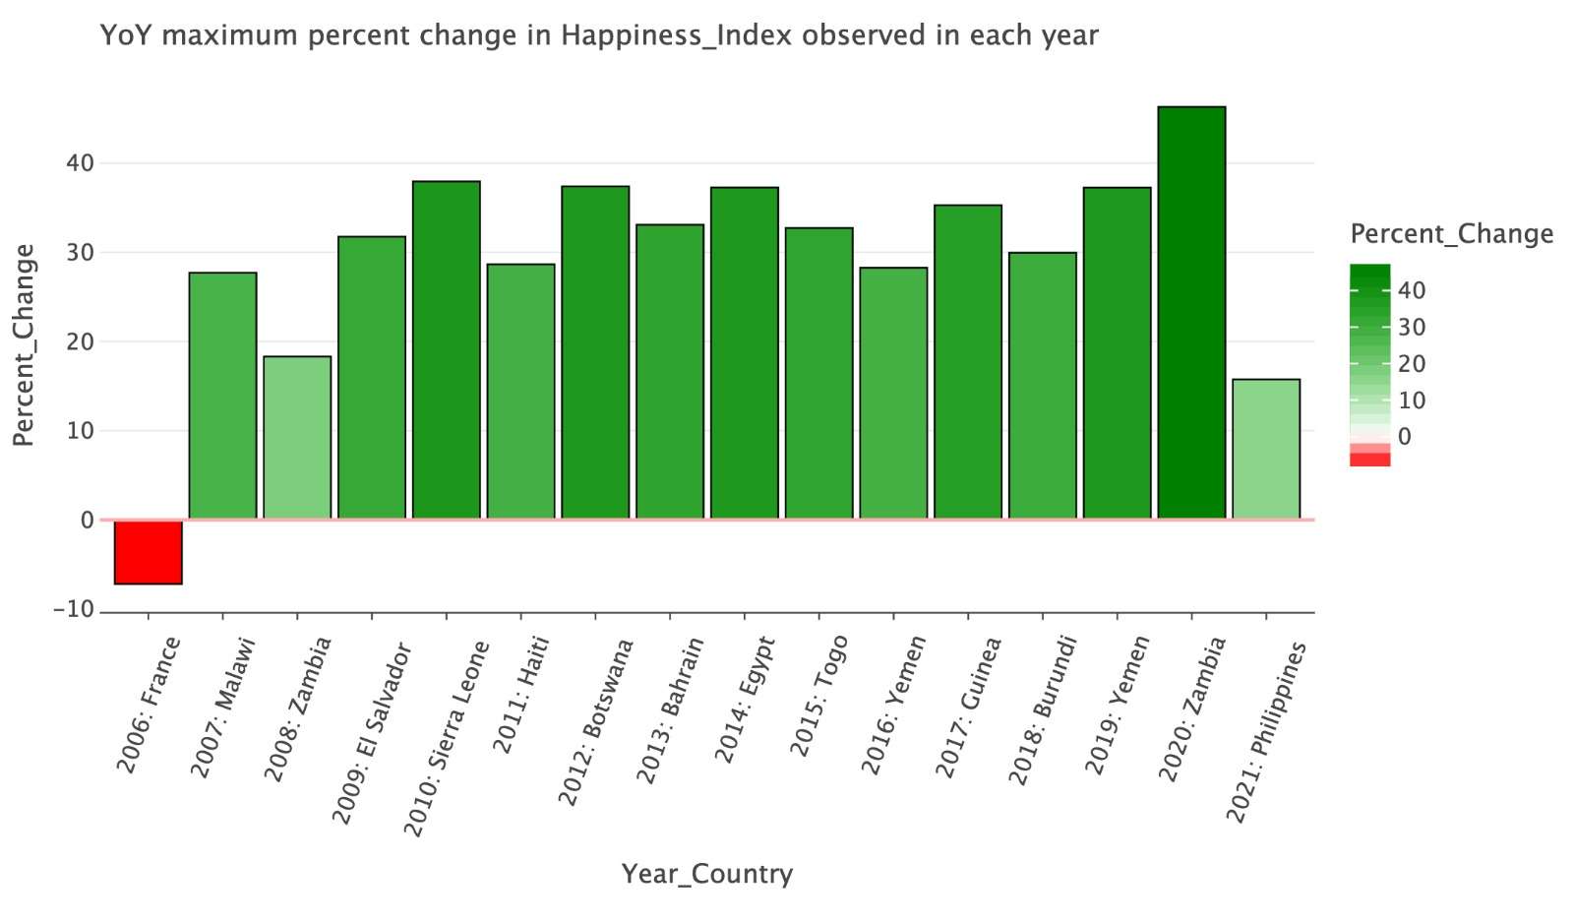
What are the most drastic changes in happiness YoY?
Given this information, we can investigate each country on this list over its given year to see what policies, projects, or events occurred, leading to the large rise/decline in its happiness

Slide 13
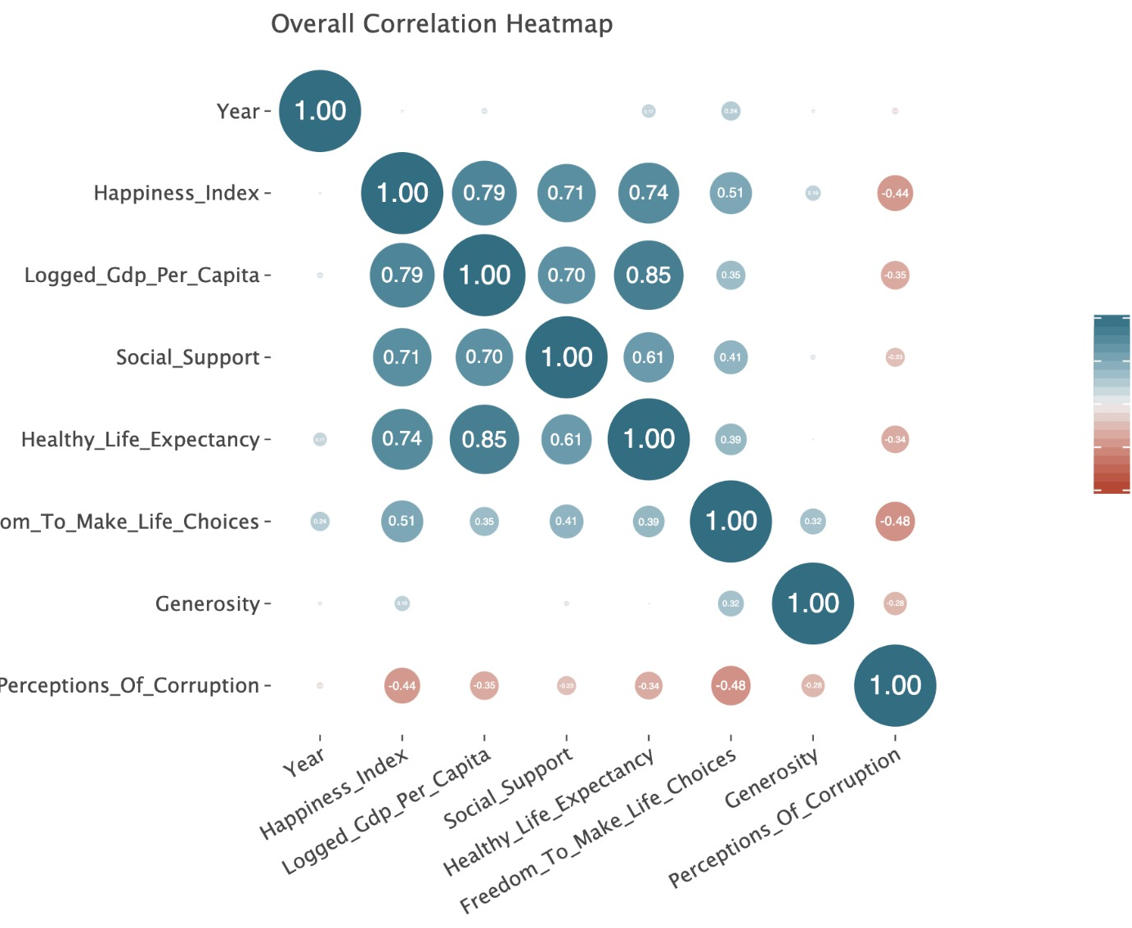
How do the different indicators affect one another?
Holistic view on indicator correlations
Surprisingly, “GDP/Capita” has no affect on “Generosity”!
Strong correlation between “GDP/Capita” and happiness
Overall, the indicators remain constant overtime (implies no major change is occurring region-wise or on a mass scale country-wise!)

Slide 14
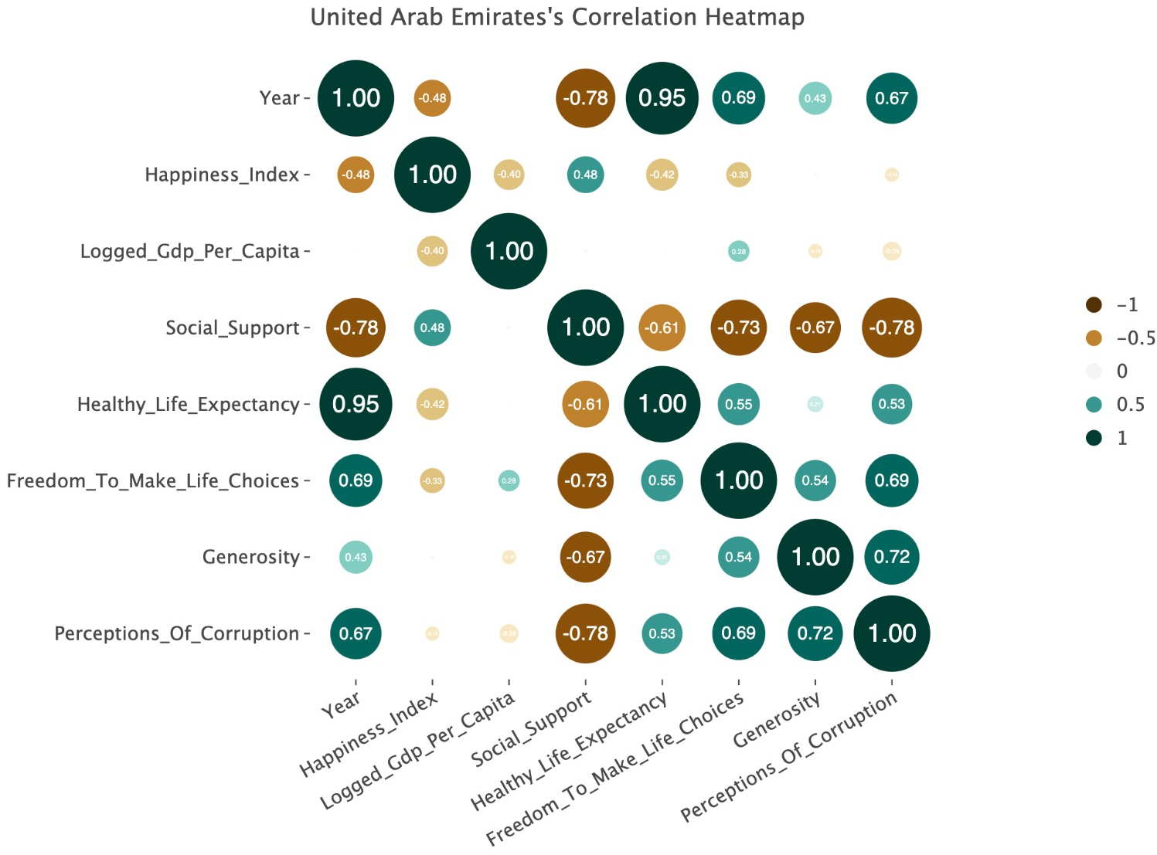
UAE’s indicator correlation heatmap
Local view on indicator correlations
Important to assess the progress of our nation and reflect on what needs to be improved

Slide 15
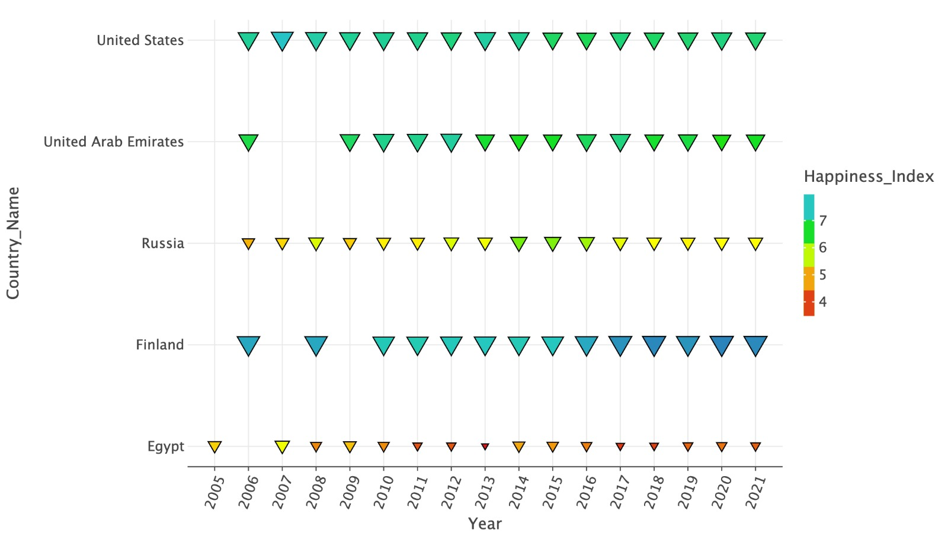
How UAE’s happiness overtime compares with major countries

Slide 16
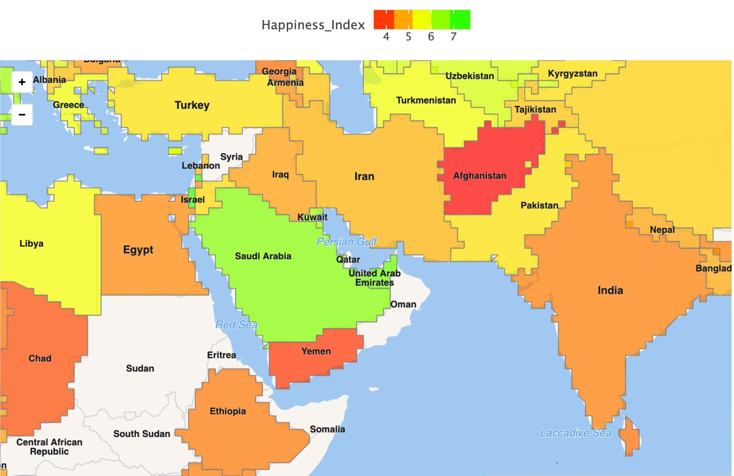
Average happiness worldwide: focused on UAE’s neighbors
Given that the UAE is leading in happiness locally and regionally, it needs to avoid the mistakes of its relatively sad neighbors and maintain a healthy relationship with the happy ones

Slide 17
Conclusion
The World Happiness Report provides a quantitative assessment of happiness levels in different countries and regions, using a range of key factors such as income, social support, and life expectancy that can be utilized to drive strategic change
By tracking changes in happiness levels over time and comparing them across countries, the report helps policymakers and researchers identify trends and patterns that can inform policy decisions, making human happiness a central goal of policy
The report serves as a valuable tool for policymakers, researchers, and the general public to better understand the factors that contribute to happiness and well-being, and to use this knowledge to create more effective and equitable policies that improve people's lives

